Slide 1
Chapter 2: Probability

Slide 2

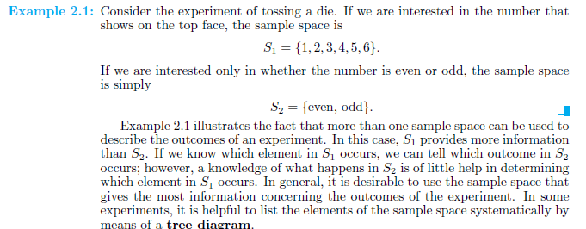

Slide 3
Sample Space
The Sample Space is the collection of all possible events
e.g. All 6 faces of a die:
e.g. All 52 cards of a bridge deck:

Slide 4

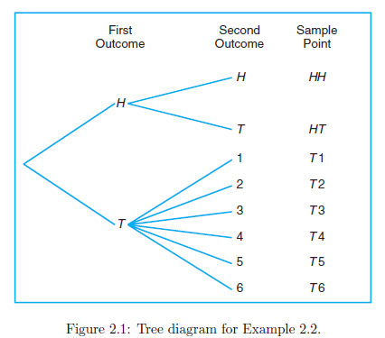


Slide 5
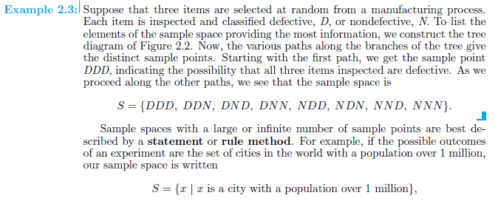
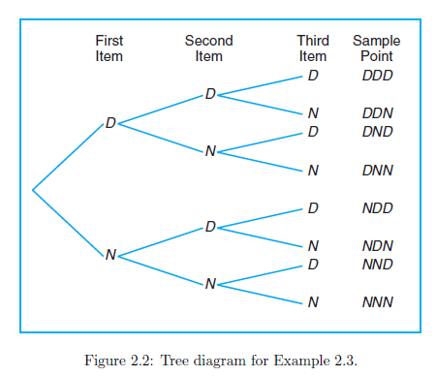

Slide 6
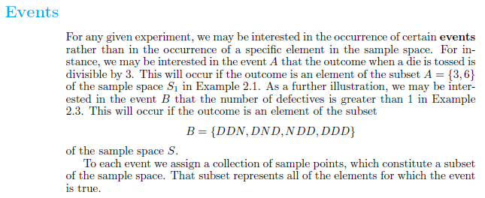
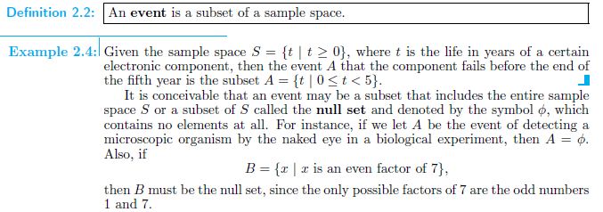

Slide 7
